Slide 2
“What is the Height
of Your Ambition?”
Exploring A
Pre-professional
Health Career Path
Linwood Webster

Slide 3
Agenda
Welcome/Introduction
Background
Vision (Journey)
Takeaways
Q&A

Slide 4
Who?

Slide 5
“What is the Height
of Your Ambition?”

Slide 6
??

Slide 7
Agenda
Welcome/Introduction

Slide 8
WELCOME

Slide 9
Linwood Webster
Assistant Director
of Health and Law
Professions Advising

Slide 10
“What is the Height
of Your Ambition?”

Slide 11
Exploring A
Pre-professional
Health Career Path

Slide 12
EXPLORE HEALTH CAREERS
Clinical Lab Science
Medical (including Allopathic, Osteopathic, and MD/PhD)
Dental
Optometry
Nursing
Occupational Therapy
Chiropractic
Pharmacy
Physical Therapy
Physician Assistant
Public Health
Podiatry
Veterinary
Speech Language Pathology
Acupuncture/Eastern Medicine
Athletic Training
Complementary/Integrative Medicine

Slide 13
“What is the Height
of Your Ambition?”

Slide 14
??
BIG
S.T.E.P.S.
U.P.

Slide 15
Agenda
Welcome/Introduction
Background

Slide 16
Background

Slide 17
Education
UNC-Wilmington, Wilmington, NC
Ed.D. - Higher Education Leadership – May 2026
NC State University, Raleigh, NC.
M. Ed. Counselor Education Program –
Clinical Mental Health – May 2017
Duke University – Graduate Studies – Public Policy
post-graduate studies Fall 2015
University of North Carolina at Chapel Hill, NC.
post-graduate studies Spring 2004
Harvard University Grad. Sch. of Ed., Cambridge, MA
post-graduate studies Spring 2003
University of North Carolina at Chapel Hill, NC.
M.S. Information Science May 2002
Durham Technical Comm. College, Durham, NC
Microcomputer Curriculum 08/1994 – 05/1995
North Carolina Central University, Durham, NC.
B.A. English (Media/Journalism) 1991

Slide 18
Professional
Academic Advisor-18+ yrs.
Career Coach-18+ yrs.
Clinical Counseling-15+ yrs.
STEM Field-30+ yrs.
2-yr., 4-yr., HBCU, HWI, Public/Private

Slide 19
Professional
Over 18+ yrs. of advising ALL students, ALL Majors at UNC Chapel Hill
Over 18+ yrs. of advising students on Health Profession pathways
Make UNC Chapel Hill students take Patient Internship class in UNC Medical School for Networking Purposes.

Slide 20
Agenda
Welcome/Introduction
Background
Vision (Journey)

Slide 21
Vision

Slide 22
“First
Steps”…

Slide 23
EXPLORE HEALTH CAREERS
Clinical Lab Science
Medical (including Allopathic, Osteopathic, and MD/PhD)
Dental
Optometry
Nursing
Occupational Therapy
Chiropractic
Pharmacy
Physical Therapy
Physician Assistant
Public Health
Podiatry
Veterinary
Speech Language Pathology
Acupuncture/Eastern Medicine
Athletic Training
Complementary/Integrative Medicine

Slide 24
Top 10 MED
Harvard
New York University (NYU)
Columbia University
John Hopkins
University of San Francisco
Duke University
University of Penn
Stanford University
University of Washington
Yale University
#25 UNC Chapel Hill

Slide 25
@ College
First Year – Do I Fit/Do I Belong?
Sophomore Year – Is NC State Really The Place For Me?
Junior Year – Will NC State be
Worth It? Am I Doing Enough?
Can I Make It?
Senior Year – Did I Do Enough?
Was It Worth It? What’s Next?

Slide 26
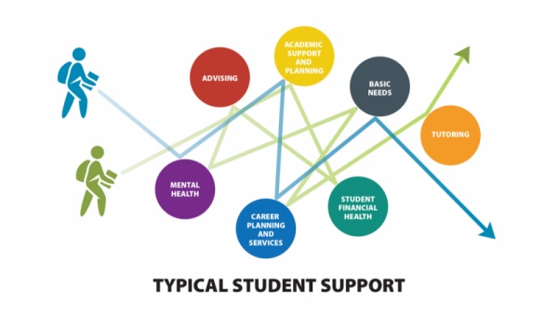
Disjointed and Disconnected
Silo & Tunnel Vision

Slide 27
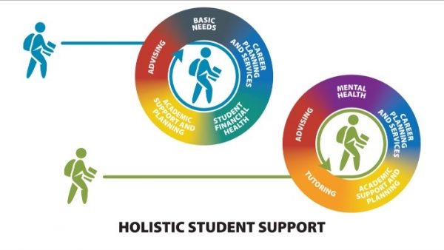
My Professional Work

Slide 28
Professional
Academic Advisor-18+ yrs.
Career Coach-18+ yrs.
Clinical Counseling-15+ yrs.

Slide 29
Student-Centered
Academic
Advising
Baseline
Clinical
Counseling
Holistic
Approach
(Anxiety)
Career
Coaching
Combined Academic Affairs and Student Affairs Model

Slide 30
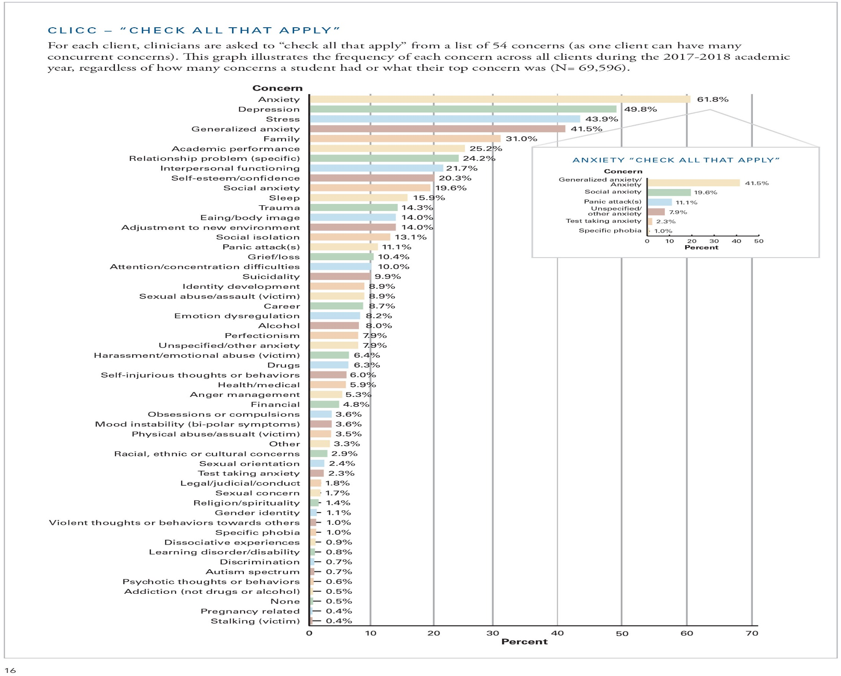

Slide 31
What I Offer
Unpack
Pre & Post-
Graduation
Anxiety!
Work/
Internship
Wellness
Family
Tuition
Family
=
Wellness
Social
Distance
Life
Classes
Tuition
Work
Classes
Life
Campus
Life
Social
Distance
Pandemic-
Crisis
Campus
Life
Pandemic
post-Graduation plans MED SCHOOL

Slide 32
Health Professions Advising @ NC State
Assist you with:
Prerequisite course selection, Majors & Minors
Becoming a competitive candidate
Selecting potential health professions schools
Application materials, timelines & letters of recommendation
Personal statement assistance
Interview tips & preparation
Gap year strategies

Slide 33
Health Professions Advising @ NC State
Getting Started
Want to get off to a good start as a NC State pre-health student?
Review all of the Health Professions website
Join the pre-health listserv and stay informed
Meet with the pre-health peer advisor, weekly drop-in hours are available in the fall and spring

Slide 34
Health Professions Advising @ NC State
Gaining Experience:
The health professions require significant clinical experience in order to become a competitive candidate. The schools want students to be as sure as they can that the profession is right for them as a career choice and to get experiences that give them a good idea of what the profession is all about.
How to gain experience:
Health care practices and organizations that contact us with job openings are posted in the NC State ePACK software system.
Students get positions on their own. Taking the initiative and networking is how students often get positions (volunteer, shadowing, part-time and summers).

Slide 35
Health Professions Advising @ NC State
Some ideas for accessing people and places for networking, getting contacts, leads and referrals.
*family and friends
*your personal health care office (doctor, dentist, etc)
*free and low cost health clinics
*hospital volunteer offices
*assisted living facilities, hospice centers
*professional schools in NC – ask if they assist with contacts who have graduated from their program
*professional associations – some have a mentoring program
*NCSU pre-health students, student club members and officers (a rich network of contacts)
*Minority Association of Pre-health Students (M.A.P.S.)
*referrals – one health care professional knows many others they could suggest
Examples of places to start:
Hospitals – UNC Health, WakeMed Health, Duke Health Clinics –
Urban Ministries of Wake County, Advance Community Health, Mariam Clinic

Slide 36
Health Professions Advising @ NC State
More Helpful suggestions:
Attend the annual Health Professions Fair that attracts over 80 professional schools
Consider joining the Pre-Health student club and specialty group (Medical, Dental, Physician Assistant/Nursing, Physical & Occupational Therapy, Optometry, Pharmacy, AED, DDS, Rural Health
Review the websites of 2 or 3 potential professional schools of interest. Look closely at the admissions section and FAQs.
Start gaining experience, both clinical and non-clinical (volunteer/community service)
For an overview of Health Careers see explorehealthcareers.org

Slide 37
Comfort Zone
Socially
Intellectually
Personally
Professionally
Educationally

Slide 38
@ College
Major/ Minor combinations
Interdisciplinary Studies Major
Interinstitutional enrollments –Duke & UNC*
Honor Classes as non-Honors student
Career and Professional School Fairs – (6-8)
Career and Professional School Fairs – Duke/UNC*
Potential Paths into Duke, & UNC MED Schools
Entrepreneur (Shark Tank) Competition Opportunities
Clubs and Organizations
Internships each Summer – volunteer, shadow, observations, “sit-in”
Graduate classes – UNC & Duke
Gap Year Prep Portfolio – Research and Professors
References/Resources – 2-6 Professors
“Self-placed” challenges – like Study Abroad,
Internships Abroad, Undergrad. Research, Indep. Studies, TA’s, Volunteer at El Centro, Service Learning Opps.

Slide 39
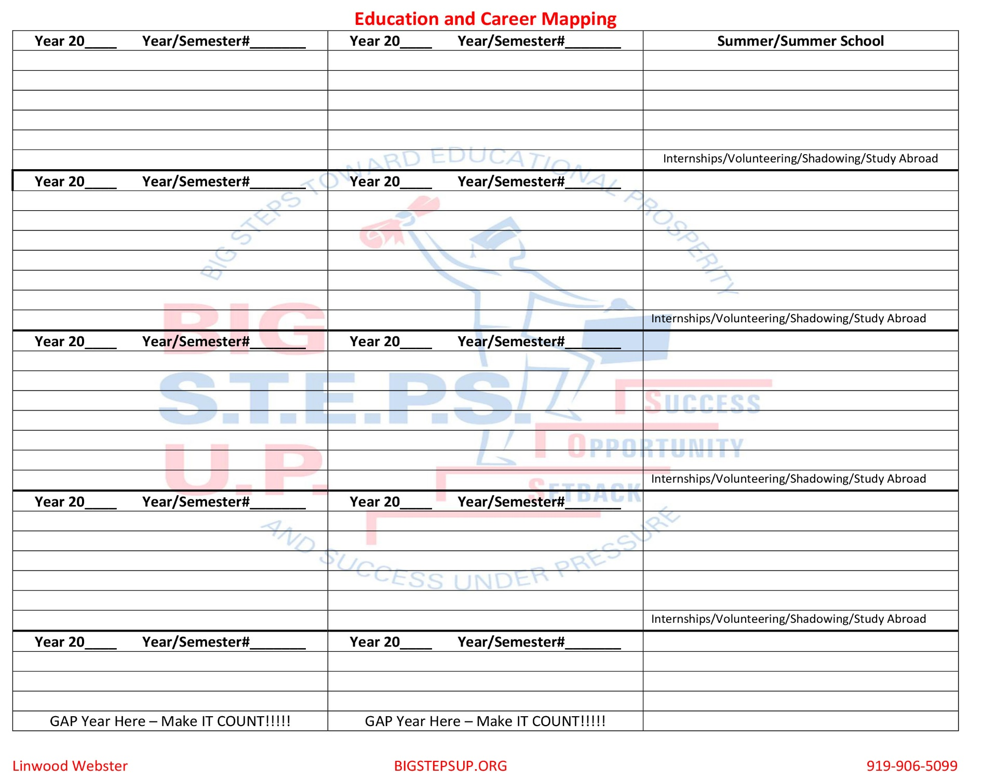

Slide 40
“What is the Height
of Your Ambition?”

Slide 41
??

Slide 42
??
#1 Harvard
#6 Duke
#25 UNC Chapel Hill
Medical Schools

Slide 43
Agenda
Welcome/Introduction
Background
Vision (Journey)
Takeaways

Slide 44
Takeaways

Slide 45
Takeaways
Your competition is not beside you, think globally!!
Entrepreneur – Start-up Medical (FREE classes @ Duke and UNC+ volunteer at the hospitals)
Digital Resources - ?
Obtain Names/Contacts of TOP/Preferred Schools/Programs(establish pipeline)
What is desired/ideal candidate profile?
What do Programs want to see on your NC State transcript? (exceed it!!)
Social Media footprint
Digital Portfolios/Gap Year Portfolio
Senior Bridge Workshop/Class – see flyer

Slide 46
Off-campus Pre-Health Resources
Health Professions Exploration Courses – @ UNC through Interinstitutional
Each of these courses are 1 credit hour and graded pass/fail.
AHSC 200. Introduction to Allied Health Sciences
BIOL 117. Pre-Health Thrive-1 Considering Health Professions
BIOL 118. Pre-Health Thrive-2 Pursuing Health Professions
ICMU 401 – Patient Facilitator Internship
INLS 770 – Health Informatics Seminar
MHCH 680 – Global Sexual and Reproductive Health
MHCH 685 – Human Sexuality
NURS 611 – Supporting the Childbearing Family
PHCY 124 – Contemporary Communications in Health Care
PUBH 420. The HIV/AIDS Course
SPGH 101 Exploring Public Health Fields

Slide 47
Senior Bridge Workshop!

Slide 48
Senior Bridge Workshop! “When The Shift Hits The Pan(demic) - Are you Socially, Academically, Financially, and Emotionally (S.A.F.E.) Prepared for Health/Law School, & Life Successes?”

Slide 49
“Play the Hand That You Are Given”

Slide 50
“What is the Height
of Your Ambition?”

Slide 51
??

Slide 52
??
#1 Harvard
#6 Duke
BIG
S.T.E.P.S.
U.P.
#25 UNC Chapel Hill

Slide 53
??
BIG
S.T.E.P.S.
U.P.
N.C. Central University
Poverty
Low-income
First-generation
At-risk

Slide 54
“From the hogpen to Harvard”
?????????
> Assistant Director of Health and Law Professions Advising
Ongoing UNC Wilmington- Ed.D.
NC State – M. Ed.
Triangle Residential Options for Substance Abusers (TROSA), Inc.
Federal Correctional Institute – Internship
N.C. State University –
Honduras & Duke Univ.
Harvard University
UNC-Chapel Hill – M.S.I.S.
BIG
S.T.E.P.S.
U.P.
N.C. Central University
Poverty
Low-income
First-generation
At-risk

Slide 55
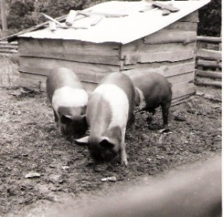
to Harvard
From the Hogpen,…

Slide 56
“Never measure a Man
by the Height that he
has reached, but by
the depth from which
he has come.”
Booker T. Washington

Slide 57
Q&A
Lwebste@ncsu.edu

Slide 58
END
END
END
END

